Slide 1
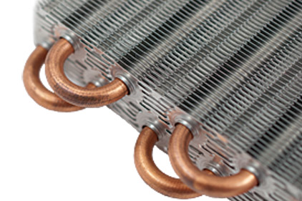
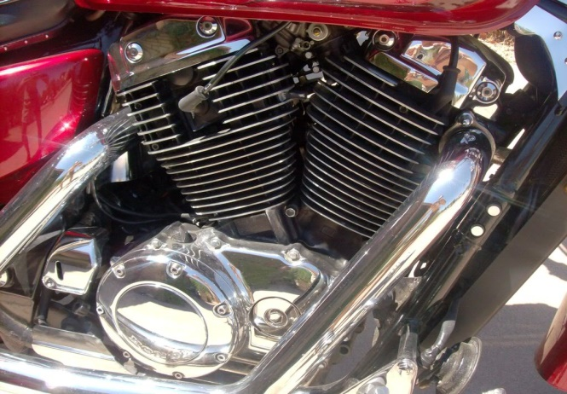
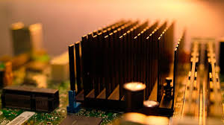
Heat Transfer
Fins

Slide 2
Introduction
Fins are generally used to enhance the heat transfer from a given surface.
Application areas of fins are:
1. Radiators for automobiles
2. Heat exchangers of a wide variety, used in different industries
3. Cooling of electric motors, transformers, etc.
4. Cooling of electronic equipment, chips, I.C. boards etc.

Slide 3
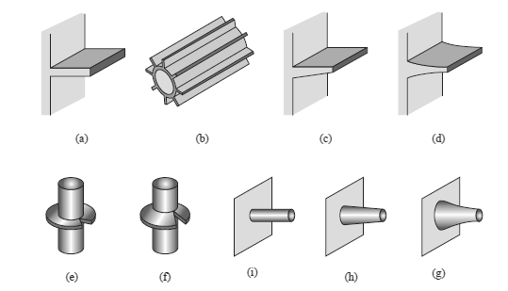
Types of fins:
There are innumerable types of fins used in practice some of the more common types are shown in Fig.
Fins of rectangular(a), circular(i), triangular(d), and conical(g)

Slide 4
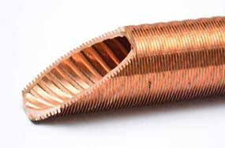
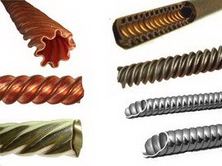
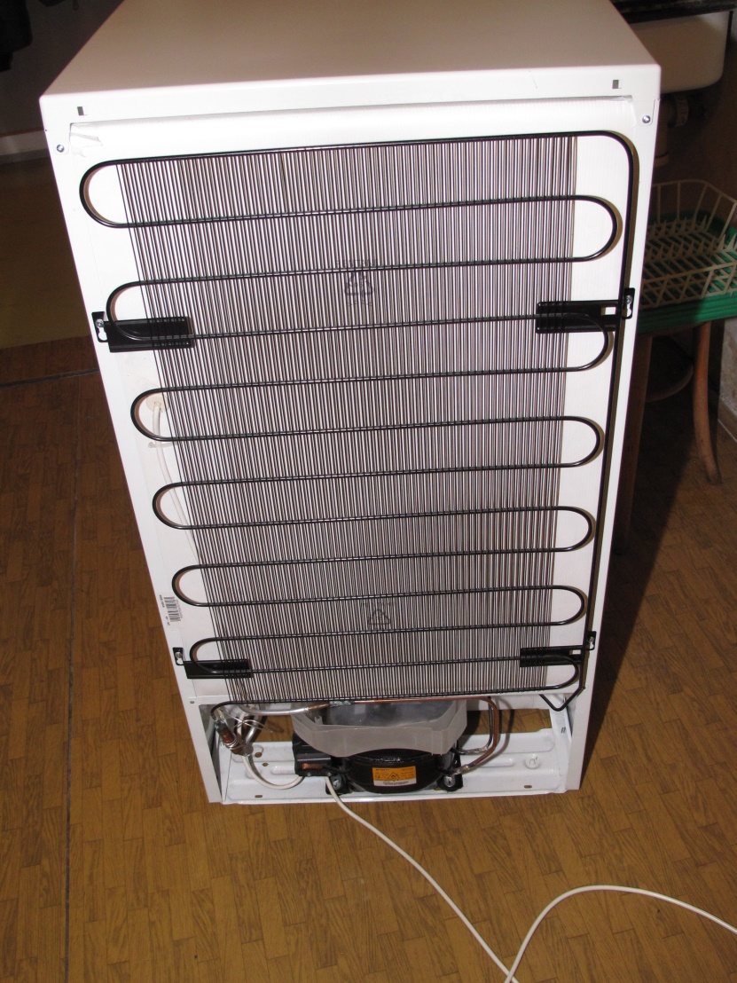
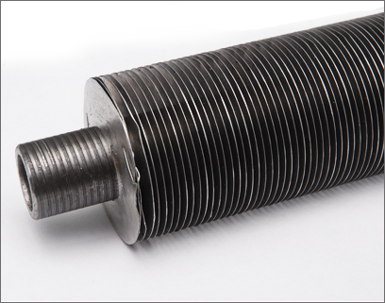

Slide 5
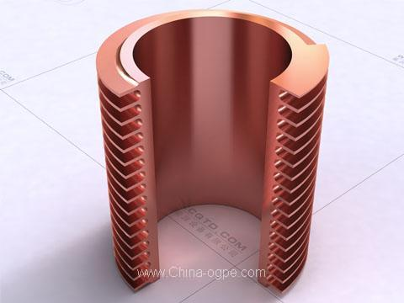
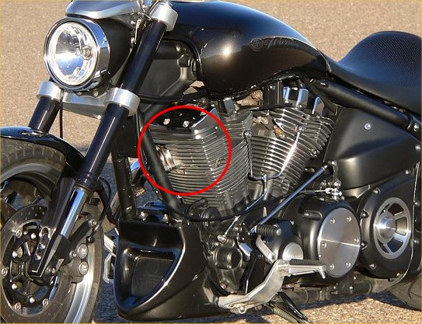

Slide 6
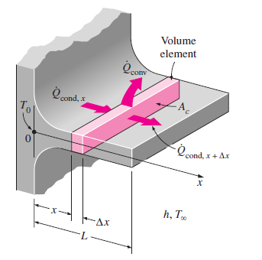
Energy going into the element by conduction =
(Energy leaving the element by conduction) + Energy leaving the surface of the element by convection)
$$Q_{x}=Q_{x+dx}+Q_{conv}$$

